Slide 1
CrediLink Product Analytics & Retention Dashboard
Data-Driven Insights for User Growth and Retention

Slide 2
Title of Project: Fintech App Product Analytics & Retention Insights for CrediLink
Presenter: Lydia Odame, Data Analyst Date: 07/01/2026

Slide 3
Executive Summary
Key Highlights:
MAU Growth: 83% decrease in the last quarter
Churn Reduction: 56.3% improvement in retention
Strong user intent: High loan demand, low cancelation rate but zero disbursement recorded
Loan application pending: 87.5% of application stuck in pending
Revenue Impact: 8.85 Billion revenue at risk identified
Recommendations:
Focus retention efforts on "Critical Risk" segment
Increase feature adoption among bill payment users to increase retention
Fix disbursement and wallet/bank integration issues
Validate loan status tracking in the app

Slide 4
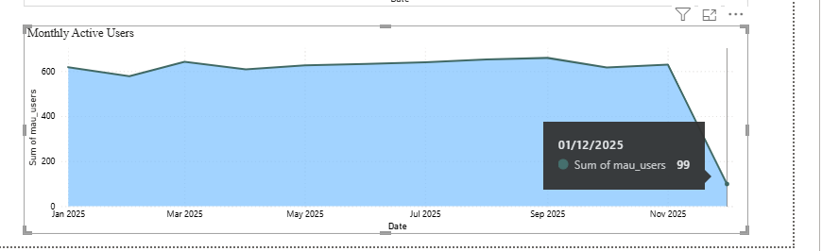
User Growth & Activity Trends
MAU Growth Trend (Line Chart)
Current MAU: 99
MoM Growth: 17%
Target: 348 by next quarter

Slide 5
Retention Analysis
Cohort Retention Curves (Line Chart)
October Cohort: 5.87% retention in October
November Cohort: 5.41% retention in November (decrease)
December Cohort: 10.09% retention in December (improvement)
Key Insight:
Highest retention among users in December
Lowest retention among users in November

Slide 6
Churn Risk Assessment
Churn Risk Distribution (Pie Chart)
Critical Risk: 25.31% (1,772 users)
Low Risk: 74.69% (5,228 users)
Revenue at Risk:
Total: 8.85 Billion
Critical Segment: 4,995,031(average revenue per at-risk-user
Low Risk Segment: Zero

Slide 7
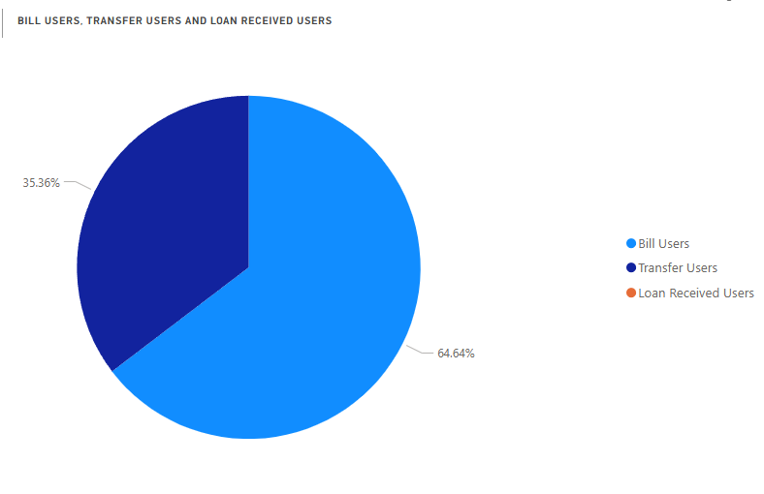
Feature Adoption Analysis
Feature Adoption Rates (Pie Chart)
Loans: 0% adoption
Bill Payments: 64.64% adoption
Transfers: 35.36% adoption
Savings :0% adoption

Slide 8
User Segmentation Insights
Segment Performance Table
Segment | Size | Churn rate | Action
android_user | 10039 | 33.51% | Prioritise app performance and UX issues
ios_user | 6755 | 33.48% | Prioritise app performance and UX issues
web_user | 10255 | 33.01% | Prioritise web performance and UX issues
Payment_type | 13841 | 1.76% | Maintain current payment flow performance
Is_referred (referral type) | 6285 | 0.86% | Strengthen referral programs to expand user referrals

Slide 9
Predictive Insights
Machine Learning Findings:
Top 3 Churn Predictors:
  Days since last active day (<91 days)
  No savings activity
  Preferred payment method: Wallet balance
Model Accuracy: 98% precision in predicting churn
Implementation: Model deployed in Power BI dashboard

Slide 10
Recommendations & Action Plan
Quarterly Objectives:
  Immediate Actions (Next 30 days):
    Fix loan disbursement and wallet bank integration to unblock 87.5% pending loans
    Audit and validate loan status tracking and event logging in the app
    Resolve critical Android, iOS, and Web performance issues impacting high-churn users
    Launch targeted retention nudges for Critical Risk users (1,772 users) identified by the Machine Learning model
    Re-engage inactive users last active < 91 days with push and in app messaging
  Strategic Initiatives (Next 90 days):
    Redesign loan flow to reduce approval and disbursement delays
    Introduce savings activation journeys to reduce churn risk
    Scale referral acquisition given lowest churn rate segment
    Increase bill payment feature adoption to improve retention and MAU growth
    Automate churn prediction driven interventions in Power BI
  Product Improvements:
    Add loan application sub statuses for better visibility and control
    Improve wallet balance payment reliability and success rates
    Optimize onboarding to drive early feature adoption
    Introduce clear user communication during loan pending stages
    Enhance cross platform UX consistency
  Additional Key Recommendations:
    Focus revenue protection on Critical Risk users contributing 8.85 Billion at risk
    Track ARPU and retention by feature adoption and platform
    Set SLAs for loan processing and pending resolution
    Use December cohort retention drivers to replicate successful behavior

Slide 11
Dashboard Walkthrough
Power BI Dashboard Sections:
Executive View: Top KPIs at a glance
Trend Analysis: Daily/Monthly trends
Cohort Analysis: Retention curves
Risk Assessment: Churn prediction scores
Segmentation: User behavior clusters
Drill-Through: Individual user details

Slide 12
Appendix & Q&A
Data Sources
https://www.kaggle.com/datasets/niketdheeryan/fintech-users-data
https://www.kaggle.com/datasets/harunrai/fintech-customer-life-time-value-ltv-dataset
https://www.kaggle.com/code/malyshevartem/product-metrics-and-retention-analysis
https://www.kaggle.com/datasets/mustafakeser4/bigquery-fintech-dataset
MySQL Workbench
Tools Used: Python, Power BI, SQL, Excel, Google Slide
Contact: Lydiaseniodame@gmail.com
Dashboard Access: lydyaforson18@outlook.com
Q&A

